Slide 1

DESIGN AND ANALYSIS OF ALGORTIHMS
Assignment on Graph algorithms
Name: Achanta Pavan Santhosh Manideep
Roll no: 181210004

Slide 2
Graph Traversal Algorithms
Traversing a graph means examining the nodes and edges of the graphs.
There are 2 standard algorithms for graph traversal:
Breadth First Search (BFS)
Depth First Search (DFS)
Both these algorithms make use of a variable “STATUS”.
This variable describes the state of the node whether it is ready or waiting or processed.

Slide 3
Breadth First Search (BFS)
Uses Queue to store and process the nodes
Features of BFS:
Algorithm for BFS
Time Complexity: O(|V| + |E|)
Completeness: This algorithm is a complete algorithm as it gives solution for any kind of graph
Optimality: BFS is optimal for graph that has edges of equal length, since it always returns the result with fewest edges between the start node and goal node.
Step 1: SET STATUS = 1 (ready state) for each node in G
Step 2: Enqueue the starting node A and set its STATUS = 2 (waiting state)
Step 3: Repeat Steps 4 and 5 until QUEUE is empty
Step 4: Dequeue a node N. Process it and set its STATUS = 3(processed state).
Step 5: Enqueue all the neighbours of N that are in the ready state (whose STATUS = 1) and set their STATUS = 2 (waiting state)
[END OF LOOP]
Step 6: EXIT
Applications of BFS:
Finding all connected components in graph
Finding all nodes within individual connected component
Finding shortest path between two nodes ‘u’ and ‘v’ of an unweighted or weighted graph.

Slide 4
Depth First Search (BFS)
Uses Stack to store and process the nodes
Features of DFS:
Algorithm for DFS
Time Complexity: O(|V| + |E|)
Completeness: This algorithm is a complete algorithm as it gives solution for any kind of graph
Optimality: BFS is optimal for graph that has edges of equal length, since it always returns the result with fewest edges between the start node and goal node.
Step 1: SET STATUS = 1 (ready state) for each node in G
Step 2: Push the starting node A on stack and set its STATUS = 2 (waiting state)
Step 3: Repeat Steps 4 and 5 until STACK is empty
Step 4: Pop the top node N. Process it and set its STATUS = 3(processed state).
Step 5: Push all the neighbours of N on to the stack that are in the ready state (whose STATUS = 1) and set their STATUS = 2 (waiting state)
[END OF LOOP]
Step 6: EXIT
Applications of DFS:
Finding all connected components in graph
Finding all nodes within individual connected component
Finding shortest path between two nodes ‘u’ and ‘v’ of an unweighted or weighted graph.

Slide 5
Spanning Tree
A spanning tree of a connected, undirected graph G is the sub graph of G, which is a tree that connects all its vertices together
A graph can have any number of spanning trees.
We can assign weights to the edges in the graphs.
The weight of a spanning tree is the sum of weights of all edges that are connected in the tree.

Slide 6
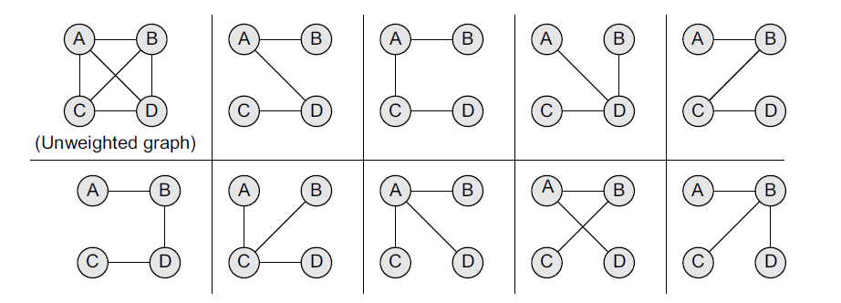
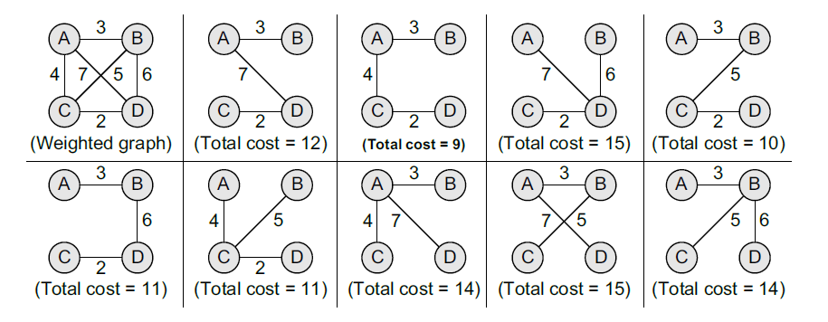
Unweighted Graph and its spanning trees
MST
Weighted Graph
and its spanning trees

Slide 7
Minimum Spanning Tree (MST)
The spanning tree whose weight is less than or equal to the weight of every other spanning tree among all the spanning trees of a graph
Properties of MST:
Applications of MST:
There can be multiple spanning trees of the same weight.
Even each edge in the graph is assigned a different weight, then there will be only a unique MST
If there exists a cycle C, in a graph G that has a weight larger than that of other edges of C, then this edge cannot belong to MST.
MSTs can be computed quickly and easily to provide optimal solutions
MSTs are used in designing networks
MSTs are used to find airline routes
MSTs are applied in routing algorithms for finding the most efficient path
Used to find the cheapest way to connect terminals like cities, electronic components, computers etcetera.

Slide 8
Prim’s Algorithm
Greedy algorithm
Used to form a MST for a connected, weighted undirected graph
The algorithm builds a tree that includes every vertex and a subset of the edges in such a way that the total weight of all the edges in the tree is minimized.
The algorithm maintains three sets of vertices which can be given as below:
Tree vertices: Vertices that are a part of the minimum spanning tree T.
Fringe vertices: Vertices that are currently not a part of T, but are adjacent to some tree vertex.
Unseen vertices: Vertices that are neither tree vertices nor fringe vertices fall under this category
Prim’s Algorithm
Step 1: Select a starting vertex
Step 2: Repeat steps 3 to 4 until there are fringe vertices
Step 3: Select an edge E containing the tree vertex and fringe vertex that has minimum weight.
Step 4: Add the selected edge and vertex to the MST
Step 5: EXIT
Running time = O(E log V)

Slide 9
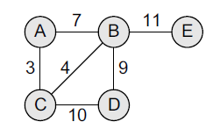
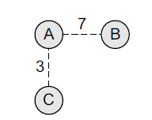

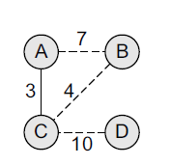
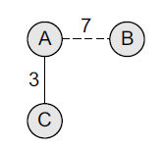
Example (MST):
Construct the MST for the graph given
Step-1 : Choose a starting vertex A.
Step-2 : Add the fringe vertices (that are adjacent to A). The edges connecting the vertex and fringe vertices are shown with dotted lines.
Step-3 : Select an edge connecting the tree vertex and the fringe vertex that has the minimum weight and add the selected edge and the vertex to the minimum spanning tree T.
Step-4 : Add the fringes that are adjacent to C

Slide 10
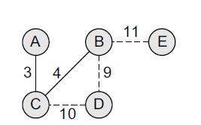
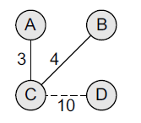
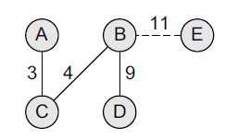
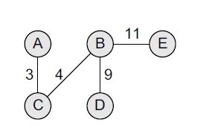
Step-5 : Select an edge connecting the tree vertex and the fringe vertex that has the minimum weight and add the selected edge and the vertex to the minimum spanning tree T.
Step-6 : Add the fringe vertices (that are adjacent to B).
Step-8 : Note, now node E is not connected, so we will add it in the tree because a minimum
spanning tree is one in which all the n nodes are connected with n–1 edges that have minimum
weight. So, the minimum spanning tree can now be given as,
Step-7 : Select an edge connecting the tree vertex and the fringe vertex that has the minimum weight and add the selected edge and the vertex to the minimum spanning tree T.

Slide 11
Krushkal's Algorithm
Greedy Algorithm
Used to form a MST for a connected, weighted graph
The algorithm aims to find the subset of edges that forms a tree that includes all the vertices of the graph.
The total weight of all edges in the tree is minimized.
If a graph is not connected, then it finds the minimum spanning forest which is the set of minimum spanning tree
Uses priority queues in which the edges that have minimum weight takes priority over other edges in the graph.
Krushkal’s Algorithm
Step 1: Create a forest in such a way that each graph is a separate tree
Step 2: Create a priority queue Q that contains all edges of the graph.
Step 3: Repeat steps 4 and 5 while Q is not empty
Step 4: Remove an edge from Q
Step 5: IF the edge obtained in step 4 connects two trees then add it to forest.
ELSE discard the edge
[End of loop]
Step 6: EXIT
Running time = O(E log V)

Slide 12
Single Source Shortest Path Algorithm
Single Source Shortest Path Algorithms are the algorithms in which the shortest path from a given source vertex and all the other vertices are found
The common examples for single source shortest path algorithms are:
Dijkstra’s Algorithm - Uses Greedy Approach
Bellman Ford Algorithm - Uses Dynamic Programming

Slide 13

Dijkstra's Algorithm
Single source shortest path algorithm
Greedy Algorithm
Given a graph G and a source node A, the Dijkstra’s algorithm is used to find the shortest path between A and all the other nodes.
Running time = $O({\left|V\right|}^{2})$
Dijkstra’s Algorithm
1. Select the source node also called the initial node.
2. Define an empty set N that will be used to hold nodes to which a shortest path has been found.
3. Label the initial node with , and insert it into N.
4. Repeat Steps 5 to 7 until the destination node is in N or there are no more labelled nodes in N.
5. Consider each node that is not in N and is connected by an edge from the newly inserted node.
6. (a) If the node that is not in N has no label then SET the label of the node = the label of the newly inserted node + the length of the edge.
(b) Else if the node that is not in N was already labelled, then SET its new label = minimum (label of newly inserted vertex + length of edge, old label)
7. Pick a node not in N that has the smallest label assigned to it and add it to N.

Slide 14
Dijkstra’s algorithm labels every node in the graph where the labels represent the distance (cost) from the source node to that node.
There are two kinds of labels: temporary and permanent.
Temporary labels are assigned to nodes that have not been reached.
Permanent labels are given to nodes that have been reached and their distance (cost) to the source node is known.
A node must be a permanent label or a temporary label, but not both.
The execution of this algorithm will produce either of the following two results:
1. If the destination node is labelled, then the label will in turn represent the distance from the source node to the destination node.
2. If the destination node is not labelled, then there is no path from the source to the destination node.

Slide 15
All Pair Shortest Path Algorithm
All Pair Shortest Path Algorithms are the algorithms in which the shortest path is found between all pairs of vertices in the graph.
The common examples for all pair shortest path algorithms are:
Floyd Warshall’s Algorithm
Dijkstra’s Algorithm (By applying this to every node in the graph)

Slide 16


Floyd Warshall's Algorithm
All pair shortest path algorithm
Given a graph G, the Floyd Warshall’s algorithm is used to find the shortest path between all the pairs of vertices.
Running time = $O({\left|V\right|}^{2})$
Floyd Warshall’s Algorithm
1. [Initialize the Path Matrix] Repeat Step 2 for i = 0 to n-1, where n is the number of nodes in the graph
2. Repeat Step 3 for j = 0 to n-1
3. IF A[i][j] = 0, then SET P[i][j] = 0
ELSE P[i][j] = 1
[END OF LOOP]
[END OF LOOP]
4. [Calculate the path matrix P] Repeat Step 5 for k = 0 to n-1
5. Repeat Step 6 for i = 0 to n-1
6. Repeat Step 7 for j = 0 to n-1
7. SET $P\left[i\right]\left[j\right]= P\left[i\right]\left[j\right] V (P\left[i\right]\left[k\right] Λ$ $P[k][j])$
8. EXIT

